Slide 1

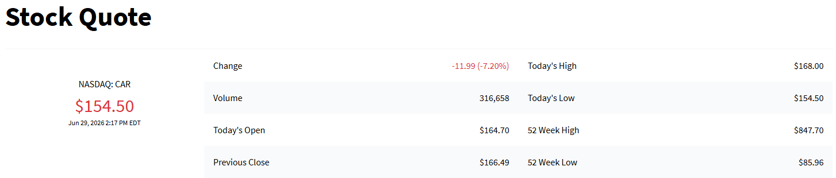

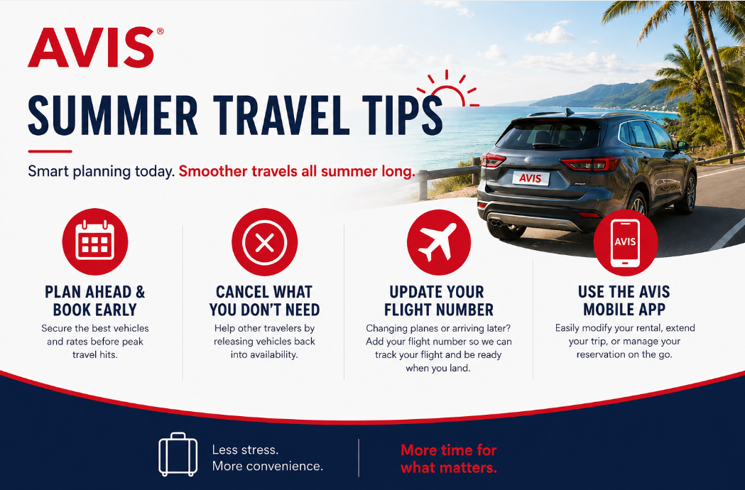




2026 3rd Quarter
Commercial Newsletter
What’s new with Avis Budget Group:
Summer Travel Tips with Avis. Page 1
Avis First Roll Out. Page 2
Updated Fleet Guides. Pages 3-4
Lead Referral Bonus Thru July 31st. Page 5
GBTA Convention Around the Corner, Chicago IL August 3-5, 2026. See you there!

Slide 2
5555555
hhhhhhhhh
7

